Slide 1

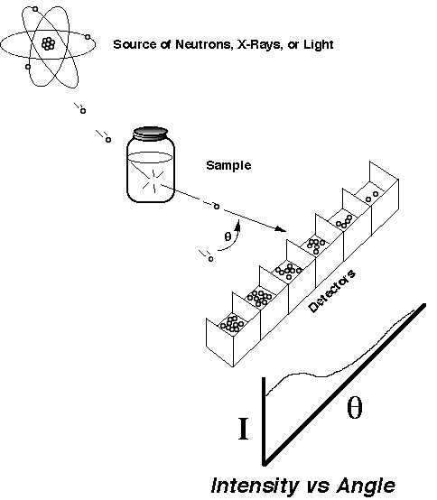
Exploring the Nanoworld with Small-Angle Scattering
Dale W. Schaefer
Chemical and Materials Engineering
University of Cincinnati
Cincinnati, OH 45221-0012
dale.schaefer@uc.edu
Basic Concepts
Why do Small-Angle Scattering?
Imaging vs. Scattering
Basic Concepts
  Scattering Vector, Fourier Trns.
  Scattering Length Density
Particle Scattering
  Guinier Approximation
  Porod’s Law
Fractal Structures
Source of x-rays, light or neutrons
XRD
SAS
SAXS & SANS: θ ≤ 6°

Slide 2
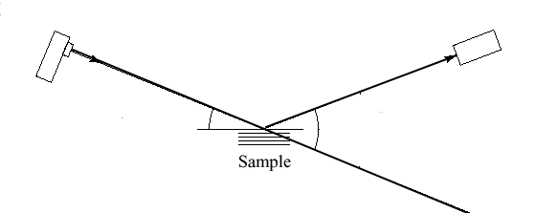

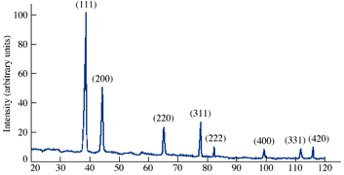
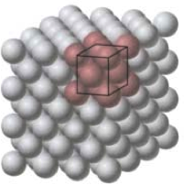
Crystals: Bragg’s Law and the scattering vector, q
source
detector
θ
SAXS: θ < 6°
d
Reciprocal space
Ordered Structures give peaks in “reciprocal” Space.
Large structures scatter at small angles.
The relevant size scale is determined by 2π/q
q is a vector.
You can’t always determine the real space structure from the scattering data.
real space
Problem: Nanomaterials are seldom ordered
Notes:
"square" is related to the "phase problem." Not really a problem. For ordered systems we want to know the real-space structure. Not necessarily true for disordered systems.
Bragg's law includes a vector. Pole parallel to q.

Slide 3
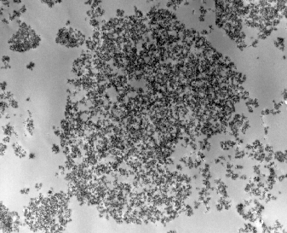
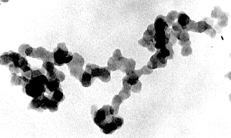
Disordered Structures in “Real Space”
Agglomerates
Precipitated Silica
10µm
(NaO) (SiO₂)_{3.3} + HCl —> SiO₂ + NaCl
Water Glass
Complex
Hierarchical
Disordered
Aggregates
10 nm
Difficult to quantify structure from images.
Primary Particles
Notes:
We don't really want to know all the positions.

Slide 4
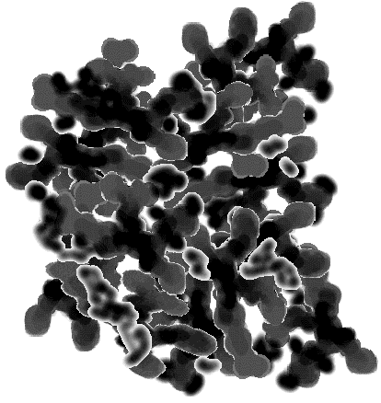

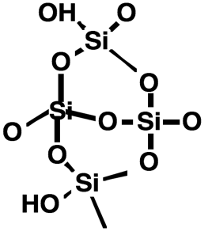

Hierarchical Structure from Scattering
Agglomerate
Aggregate
Primary
Particle
Network
“Polymer”
Four Length Scales
Four Morphology Classes
Real
Space
100,000 nm
200 nm
10 nm
0.5 nm
R
G
= 89
μ
Intensity
-3.1
Reciprocal
Space
USAS
-2.0
SAS
Exponents related to
morphology
-4.0
10
-7
10
-6
10
-5
0.0001
0.001
0.01
0.1
1
10
q [Å⁻¹] ~ Length⁻¹ ~ sin(θ/2)

Slide 5
Why Reciprocal Space?
Isotactic polystyrene foams prepared by TIPS
Jim Aubert, SNL
10 µm
Images miss similarity
Ultra-small-angle neutron scattering: a new tool for materials research. Cur. Opinion Sol. State & Mat Sci, 2004. 8(1): p. 39-47.

Slide 6

Adding up the Phases (Assume x-rays)
Many electrons
r₁
Wave scattered from one electron
r₄
r₂
r₃
scattering length of one electron
ρ(r) = bn(r)
Amplitude is the Fourier transform of the SLD distribution (almost)
Electron density distribution
n(r) = number of electrons in a volume element dr = dx dy dz around point r.
Scattering length density distribution
ρ(r) = scattering length in a volume element dr = dx dy dz around point r.
Notes:
1 occurs because one particle is at the Origin, which need not be the case.

Slide 7
Scattering Length Density (SLD) Distribution
Fourier transform of
the scattering length
density distribution
Can’t be measured
ρ(r)
Can’t be inverted
What we measure: Square of the Fourier transform of the SLD distribution

Slide 8
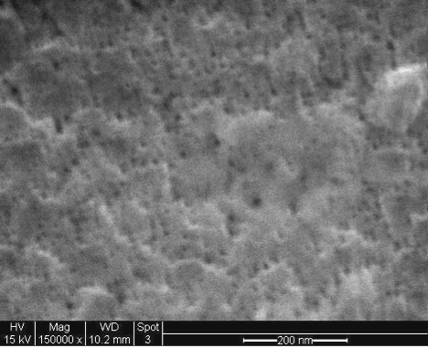
Characterizing Disordered Systems in Real Space
Correlation Function of the
Electron Density Distribution
Electron Density Distribution
Throw out phase information
Real space
ξ
r
×
r
Depends on latitude and longitude.
Too much information to be useful.
Depends on separation distance.
Retains statistically significant info.
Resolution problems at small r
Opacity problems for large r
2-dimensional
Operator prejudice
Problems with real space analysis
Notes:
It would be difficult to live in a world where eyes were sensitive to phase. Be careful what you wish for.

Slide 9
Imaging vs. Scattering
Real space
ξ
r
Reciprocal space
Schaefer, D. W. & Agamalian, M. Ultra-small-angle neutron scattering: a new tool for materials research. Curr Opin Solid St & Mat Sci 8, 39-47, (2004).
Pegel, S., Poetschke, P., Villmow, T., Stoyan, D. & Heinrich, G. Spatial statistics of carbon nanotube polymer composites. Polymer 50, 2123-2132, (2009).
ξ⁻¹
q

Slide 10
Scattering from Spherical Particle(s)
2R
ρ_{o}
v = particle volume
N particles
I(q) ~ N(ρ - ρ_{o})²v²P(q)
Form Factor
solvent SLD
Notes:
----- Meeting Notes (3/17/12 17:23) -----
Which cross section is this? What are the Units
----- Meeting Notes (3/17/12 17:29) -----
I(0) very sensitive to the large particles. Based on Bragg principles where would small particles show up.

Slide 11
Particles in Dilute Solution
ρ₁
1 particle
ρ₂
R
R_{V}

Slide 12
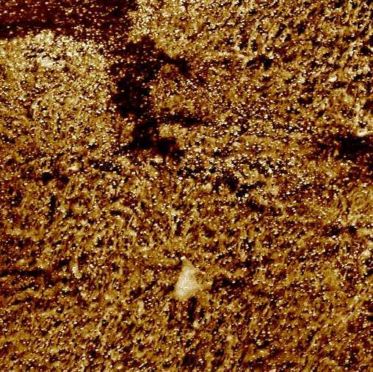
Small-Angle Scattering from Spheres
Large object scatter at small angles
Guinier Regime
Diameter = 140 Å
Silica in Polyurethane
Porod (power-law) Regime
3 μm
AFM
Petrovic, Z. S. et al. Effect of silica nanoparticles on morphology of segmented polyurethanes. Polymer 45, 4285-4295, (2004)

Slide 13
Guinier Radius
Initial curvature is a measure of length
Derived in 5.2.4.1
R_{g} ~ 1/q
Notes:
Rg = moment of inertia

Slide 14
Guinier Fits
Notes:
Logx =(ln x)/2.303
print (ln(360)-ln(50))/9.5e-4
2077.98
print sqrt(3*2077)
79 Å

Slide 15
Dense packing: Correlated Hard Spheres
R
ξ
Packing Factor = k = 8 ϕ
Å
Å
Packing Factor ≅ 6
Notes:
----- Meeting Notes (3/17/12 17:44) -----
Calculation in Extras

Slide 16
Colloidal Silica in Epoxy
EPON 862 + Cure W+ Silica
50 nm
Chen, R.S. et al, Highly dispersed nanosilica-epoxy resins with enhanced mechanical properties Polymer, 2008. 49(17): p. 3805-3815.
Exclusion zone
Notes:
The composite matrix analyzed in this work is Epon 862 epoxy
resin (diglycidyl ether of bisphenol F epoxy, Shell Corporation)
cured with EpiCure-W(diethyl diamino toluene, Shell Corporation).
Both materials were purchased from Miller-Stephenson Chemical
Company, Inc. In the remainder of this work, we refer to the cured
epoxy system (epoxy ?cure agent) as Epon862/W. This resin system
has been studied for aerospace applications due to its high
working temperature, good properties, and low viscosity [27].
These properties are all significant when resin-transfer molding
advanced carbon-fiber-reinforced composites.

Slide 17
Using R_{G}: Agglomerate Dispersion
Light Scattering
dry
sonicate
3.5 µm
D.W. Schaefer, D. Kohls and E. Feinblum, Morphology of Highly Dispersing Precipitated Silica: Impact of Drying and Sonication. J Inorg Organomet Polym, 2012. 22(3): p. 617-623.)
hard agglomerate

Slide 18
Beyond R_{G}: Hierarchical Structure from Scattering
Agglomerate
Aggregate
Primary
Particle
Network
“Polymer”
Four Length Scales
Four Morphology Classes
100,000 nm
200 nm
10 nm
0.5 nm
R
G
= 89
μ
Intensity
-3.1
USAXS
-2.0
SAXS
Exponents related to
morphology
-4.0
10
-7
10
-6
10
-5
0.0001
0.001
0.01
0.1
1
10
q [Å⁻¹] ~ Length⁻¹ ~ sin(θ/2)

Slide 19
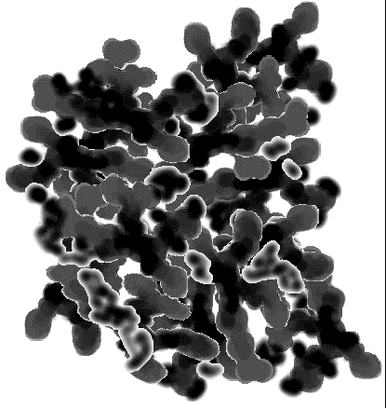
Mass-Fractal Objects
Real Space
d = 3
M ~V ~ R³
M ~V ~ R²
M ~V ~ R¹
M ~V ~ R^{2.2}
Dispersion
M~R^{d}
d = 2
Mass Fractal Dimension = d

Slide 20
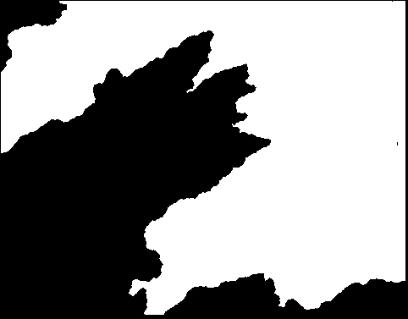
Surface Fractal Dimension
Sharp interface
S ~ R²
S ~ R^{ds}
fractal or self-affine surface

Slide 21
Porod Slope for Fractals
I(q)=q^{ds-2dm}
Structure
Scaling Relation
Porod Slope= d_{s} – 2d_{m}
d_{m} = 3
Smooth Surface
- 4
d
= 2
S
d_{m} = 3
- 3 ≤ Slope ≤ - 4
Rough Surface
2 < d
≤ 3
S
1 ≤ d_{s} = d_{m} ≤ 3
- 1 ≤ Slope ≤ - 3
Mass Fractal

Slide 22
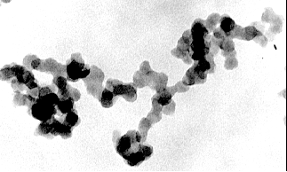
Scattering from colloidal aggregates
R
r
q^{-d}
qR = 1
Log I
q⁻⁴
qr = 1
Log q
Precipitated Silica

Slide 23
Morphology of Dimosil® Tire-Tread Silica
Two Agglomerate length Scales
Soft = Physically Bonded
Hard = Chemically Bonded
-2
Dispersion
Light Scattering
116 µm
Reinforcement
300 nm
USAXS
-4
7 µm
126 Å
Schaefer, D. W., Kohls, D. & Feinblum, E. Morphology of Highly Dispersing Precipitated Silica: Impact of Drying and Sonication. J Inorg Organomet Polym 22, 617–623 (2012).
Notes:
----- Meeting Notes (3/17/12 17:53) -----
Same light scattering data.

Slide 24
Aggregates are robust
Soft Agglomerates
shear
Hard Agglomerates
R_{agg}
Aggregates
What is the ideal aggregate size?

Slide 25
Conclusion
If you want to determine the morphology of a disordered material
use small-angle scattering.

